Slide 1
Data Preprocessing
a Collection of Problems in Data Preprocessing along with Solutions
Qi Lian
2017/2/20
Notes:
<number>

Slide 2
Overview
Introduction to Data Preprocessing
Level-1 Data Preprocessing
Hadoop MapReduce V.S. Spark
Notes:
<number>

Slide 3
Intro to Data Preprocessing:
3-V:
Volume:
Size of datasets
Variety:
Structured, Unstructured
MongoDB, MySQL
Velocity:
Speed at which data generates
Can we trust those datasets?
Can we directly apply those datasets to our algorithms?
Notes:
<number>

Slide 4
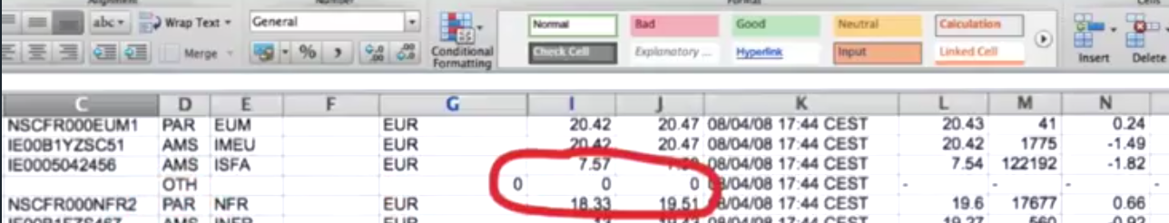

Intro to Data Preprocessing:
Can we trust those datasets?
Can we directly apply those datasets to our algorithms?
Lots of misclassified objects
Tedious execution time

Slide 5
Intro to Data Preprocessing:
Level-1:
Aim:
Maintain clean data in a uniform way in databases
Steps:
Data Cleaning
Data Integration
Level-2:
Aim:
Apply proper datasets to the target algorithms
Steps:
Data Reduction
Data Transformation
Notes:
<number>

Slide 6
Level-1: Data Cleaning
Problem I: Noise points
Behavior:
Class noise: misclassification & conflict class labels
Attribute noise: attributes that influence the classification preformance
Solution:
Noise Filters
Robust Strategies (usually based on Machine Learning algorithms)
Notes:
<number>

Slide 7
Level-1: Data Cleaning - Noise Filters
Solution 1: Noise Filters (Ensemble Filter)
Intro:
Group original datasets into T subsets
For each subset, run m filter/learning algorithms over other T-1 subsets
Compare the trained label with the actual label for each subset
Decide the correctness of the initial labels by consensus vote scheme
Remove the subset if far from idealism
Implementation:
KEEL software: http://www.keel.es/
Data Preprocessing functions are embedded in this software.
Notes:
<number>

Slide 8
Level-1: Data Cleaning - Robust Strategies
Solution 2: Robust Strategies
Intro:
Focus on the selection of the algorithms (eg. clustering...)
Not much to deal with the data itself.
Notes:
<number>

Slide 9
Level-1: Data Cleaning
Problem II: Missing Data Fields
Behavior:
Entry A has attribute a, while Entry B doesn't have;
Entry A originally has attribute a, while being eliminated by manual processing/error recording;
Solution:
Omitting
Setting default values
Notes:
<number>

Slide 10
Level-1: Data Cleaning - Omitting
Solution 1: Omitting
Intro:
Do nothing special
Just assume they don't exist
Solution:
Listwise Deletion
Delete the whole problematic entry by ignoring other useful fields
Pairwise Deletion
Only delete the problematic field while keeping the useful fields
Notes:
<number>

Slide 11
Level-1: Data Cleaning - Setting Default Values
Solution 2: Imputaion
Intro:
Deletion strategy may fail for small datasets
Get imputed values, kind of guessing
Solution:
Set the mean as default values
Retain the mean, but bad for field relationship
Linear Regression:
Amplify the current trends
Other Robust approaches involved with Machine Learning
Complicated, get first-hand errors before our ML algorithms
Notes:
<number>

Slide 12
Level-1: Data Integration
Problem I: Attributes Redundancy
Behavior:
salary/month => salary/year
Solution:
Chi-Square Correlation Test
Correlation Coefficient and Covariance
Notes:
<number>

Slide 13
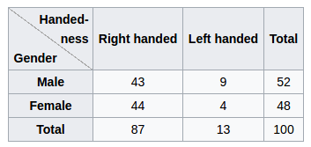
Level-1: Data Integration - Chi-Square Correlation Test
Solution 1: Chi-Square Correlation Test
Intro:
Hypothesis:
Attr_A and Attr_B (both nominal attributes) are independent of each other
Solution:
Construct the contingency table:
A: a₁,a₂,...a_{c}; B: b₁,b₂,...b_{r}
Notes:
<number>

Slide 14
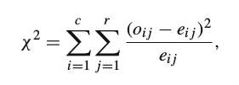
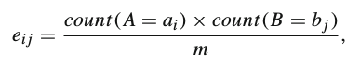
Level-1: Data Integration - Chi-Square Correlation Test
Solution (Cont.):
Apply the test formula,
o_{ij} is the observed occurrence, e_{ij} is the expected occurrence,
m is the total number of instances in the datasets:
Compare with the Chi Square statistics
Given significant level, and the degree of freedom (c-1)(r-1), get the needed value in the Chi Square statistics reference table.
Reject the hypothesis if the computed result is above the needed one.
Notes:
<number>

Slide 15
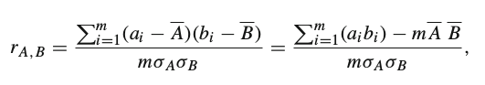
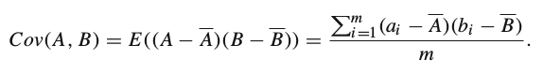
Level-1: Data Integration - Correlation Coefficient and Covariance
Solution 2: Correlation Coefficient and Covariance
Intro:
Similar to Chi-Square Correlation Test
Apply a different statistical formula (numerical):
Another validation condition:
Independent if covariance evaluated as 0
Notes:
<number>

Slide 16
Level-1: Data Integration
Problem II: Tuple Duplication and Inconsistency
Behavior:
"id" data field stored as "_id" in MySQL, while "id" in MongoDB
Solution:
Meta-data Comparison
Edit Distance
Notes:
<number>

Slide 17
Level-1: Data Integration - Meta-data Comparison
Solution 1: Meta-data Comparison
Intro:
Meta-data
The data that describes our target data
eg: Type, range, etc.
Solution:
Compare how the meta data of two fields are close to each other
Notes:
<number>

Slide 18
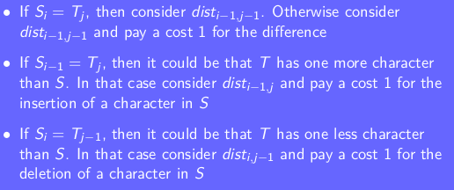
Level-1: Data Integration - Edit Distance
Solution 2: Edit Distance
Intro:
Quantitatively evaluate how one string is close to the other
Solution:
Set distance 1 for deletion, insertion, substitution
Apply Dynamic Programming to get the target distance
Notes:
<number>

Slide 19
Data Preprocessing: Level-2
To be covered by Xinyue Ou in the Monday after the next one.
Notes:
<number>

Slide 20
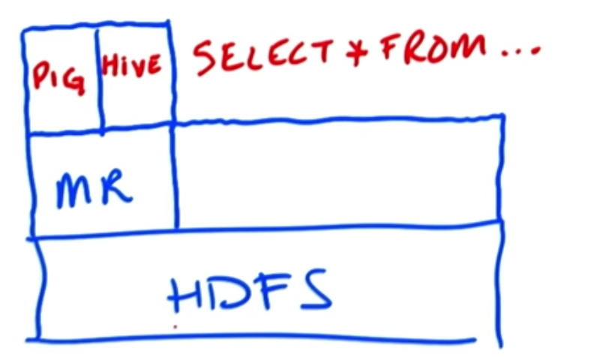
Hadoop MapReduce V.S. Spark
Review for basics of Hadoop
Hard to code raw M/R
PIG
Hive
Hadoop Streaming
General interface
Minimal Storage Unit
A block
Size: 64MB
Cluster figure
Spark
HBase
Notes:
<number>

Slide 21
Hadoop MapReduce
A computation framework for big data
Mapper:
Reducer:
All in parallel, reducer may start before mapper finishes
How does Hadoop handle the data transmission?
raw data
Map()
<key, value>
<key, value>
Reduce()
Result
Notes:
<number>

Slide 22
Hadoop MapReduce
Shuffle and Sort
Transmission Media
Network, may be the bottleneck for large datasets.
<a, 1>
raw data
Map()
<b, 1>
<a, 1>
Sort
in
partition
Merge
into
Groups
Map()
Hash
Map
raw data
<b, 1>
Reduce()
<b, 1>
raw data
Map()
<a, 1>
<c, 1>
Network
Notes:
<number>

Slide 23
Hadoop MapReduce
Is that Enough for all situations?
Pros:
Process data blocks in parallel
(not the same parallel for Qun Song's topic)
Cons:
Fixed workflow
Must have a Mapper and a Reducer
Disk-oriented
Bad for iterative algorithms working on the same datasets
Notes:
<number>

Slide 24
Spark
Another computation framework
RDD (Resilient Distributed Datasets)
Datasets:
Set of data, can be any legal data source, JSON, csv, local file, files on HDFS.
Distributed:
Split the whole datasets into partitions, more flexible
Resilient:
Spark track the working history of each partition
Reexecute the previous instructions once any error occurs.
Characteristics:
Immutable (read-only):
Easy for debugging in function calls
Kind of Thread-Safe
Notes:
<number>

Slide 25
Spark
Characteristics (Cont.):
Lazy RDD transformation:
Similar to Barrier, wait until all interpreted, triggered by certain API.
Spark will choose the best way to execute.
Pros:
In-memory process
Good for iterative algorithms, resource reusage
DAG execution engine
More phase combinations
Thread-level parallelism instead of Process-level
Each task is a thread, lighter weight
Cons:
Rely on disks if datasets can't fit in the memory
But still access higher performance than MapReduce
In-memory speed 100:1, overall speed 10:1
Notes:
Why spark is created later than Hadoop MapReduce?
<number>

Slide 26
Summary
Basic Workflow:
Fetch raw data
Data integration
Data cleaning
Store clean data in HDFS
Fetch level-1 preprocessed data
Data reduction
Data transformation
Run the target algorithm
Store results in HDFS
Python library:
Pandas
Scikit-Learn
PySpark
Notes:
<number>

Slide 27
Reference
Textbook:
Data Preprocessing in Data Mining, Springer 2014
Data Mining Concepts and Techniques, 3rd Edition, Jiawei Han
Udacity:
Intro to Hadoop and MapReduce
Data Wrangling with MongoDB
Coursera: Hadoop Platform and Application Framework
Notes:
<number>

Slide 28
END
Thanks!
Notes:
<number>

